Slide 1
Problem: Array Contains Element
Write a program which checks if element is contained in array:
5
1 2 3 4 5
yes
11
8 7 7 9 6 2 2
no
2314
99 7 8 6 2314 2
yes

Slide 2
Solution: Array Contains Element
var element = int.Parse(Console.ReadLine());
var arr = Console.ReadLine()
.Split().Select(int.Parse).ToArray();
var containsElement = false;
for (int i = 0; i < arr.Length; i++)
if (arr[i] == element)
containsElement = true; break;
if (containsElement)
Console.WriteLine("yes");
else
Console.WriteLine("no");
Check your solution here: https://judge.softuni.bg/Contests/Practice/Index/426#0/

Slide 3
Problem: Smallest Element in Array
Write a program that finds the smallest element in an array:
1 2 3 4 5
1
9 8 7 82 78 13
7
78 77 1268 43 9
9

Slide 4
Solution: Smallest Element in Array
var arr = Console.ReadLine()
.Split().Select(int.Parse).ToArray();
var min = int.MaxValue;
for (int i = 0; i < arr.Length; i++)
{
if (arr[i] < min)
{
min = arr[i];
}
}
Console.WriteLine(min);
Check your solution here: https://judge.softuni.bg/Contests/Practice/Index/426#1/

Slide 5
Problem: Reverse Array in Place
Write a program which reverses an array without using a second collection (like List<T>, etc…)
1 2 3 4 5
5 4 3 2 1
1 4 2 7 6 1 1
1 1 6 7 2 4 1
11 52 43 12 1 6
6 1 12 43 52 11

Slide 6
Solution: Reverse Array in Place
var arr = Console.ReadLine()
.Split()
.Select(int.Parse)
.ToArray();
for (int i = 0; i < arr.Length / 2; i++)
{
var temp = arr[i];
arr[i] = arr[arr.Length - 1 - i];
arr[arr.Length - 1 - i] = temp;
}
Console.WriteLine(string.Join(" ", arr));
Check your solution here: https://judge.softuni.bg/Contests/Practice/Index/426#2

Slide 7
What is a Sorting Algorithm?
Sorting algorithm
An algorithm that rearranges elements in a list
In increasing order
Elements must be comparable

Slide 8

Sorting – Example
Efficient sorting algorithms are important for
Producing human-readable output
Canonicalizing data – making data uniquely arranged
In conjunction with other algorithms, like binary searching
Example of sorting:
Unsorted list
sorting
Sorted list
10 | 3 | 7 | 3 | 4
3 | 3 | 4 | 7 | 10

Slide 9
Bubble Sort
Bubble sort – simple, but inefficient algorithm (visualize)
Swaps to neighbor elements when not in order until sorted
Example:

Slide 10
Problem: Sort Array Using Bubble Sort
Write a program which sorts an array using Bubble Sort :
5 3 4 1 2
1 2 3 4 5
11 872 673 1 2
1 2 11 673 872
11 52 43 12 1 6
1 6 11 12 43 52

Slide 11
Solution: Sort Array Using Bubble Sort
// todo: read input
bool swapped;
do
{
swapped = false;
for (int i = 0; i < arr.Length - 1; i++)
{
if (arr[i] > arr[i + 1])
{
Swap(arr, i, i + 1); // todo: write swap method
swapped = true;
}
}
} while (swapped);
// todo: print sorted array
Check your solution here: https://judge.softuni.bg/Contests/Practice/Index/426#3

Slide 12
Insertion Sort
Insertion sort – simple, but inefficient algorithm (visualize)
Move the first unsorted element left to its place
Example:

Slide 13
Problem: Sort Array Using Insertion Sort
Write a program which sorts an array using Insertion Sort :
5 3 4 1 2
1 2 3 4 5
11 872 673 1 2
1 2 11 673 872
11 52 43 12 1 6
1 6 11 12 43 52

Slide 14
Solution: Sort Array Using Insertion Sort
// todo: read array
for (int firstUnsorted = 0; firstUnsorted < arr.Length - 1; firstUnsorted++)
{
var i = firstUnsorted + 1;
while (i > 0)
{
if (arr[i - 1] > arr[i])
Swap(arr, i, i - 1); // todo: write Swap() method
i--;
}
}
// todo: print array
Check your solution here: https://judge.softuni.bg/Contests/Practice/Index/426#4

Slide 15
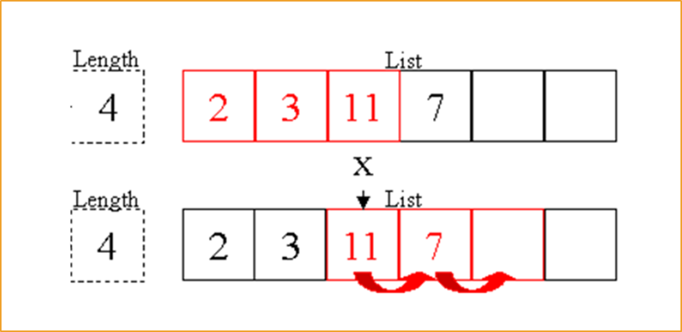
List Algorithms
Subset, Largest N elements, etc

Slide 16
Problem: Insertion Sort Using List
Read a list of integers and sort it using Insertion Sort into a result list.
5 3 4 1 2
1 2 3 4 5
11 872 673 1 2
1 1 6 7 2 4 1
11 52 43 12 1 6
6 1 12 43 52 11
Check your solution here: https://judge.softuni.bg/Contests/426/

Slide 17
Solution: Insertion Sort Using List (1)
// todo: read array
for (int arrIndex = 0; arrIndex < arr.Length; arrIndex++)
{
var inserted = false;
var currentElement = arr[arrIndex];
for (int listIndex = 0; listIndex < resultList.Count; listIndex++)
{
// continued on next slide...
Check your solution here: https://judge.softuni.bg/Contests/Practice/Index/426#5

Slide 18
Solution: Insertion Sort Using List (2)
var currentListElement = resultList[listIndex];
if (currentElement <= currentListElement)
{
inserted = true;
resultList.Insert(Math.Max(0, listIndex), currentElement);
break;
}
}
if (!inserted)
{
resultList.Add(currentElement);
}
} //todo: print resulting list
Check your solution here: https://judge.softuni.bg/Contests/Practice/Index/426#5

Slide 19
Problem: Largest N Elements
Read a list of integers and print the 3 largest elements in descending order:
5 3 4 1 2
3
5 4 3
11 872 673 1 2
2
872 673
11 52 43 12 1 6
4
52 43 12 11
Check your solution here: https://judge.softuni.bg/Contests/Practice/Index/426#6

Slide 20
Solution: Largest N Elements
var arr = Console.ReadLine()
.Split().Select(int.Parse).ToArray();
var n = int.Parse(Console.ReadLine());
// todo: sort array (in descending order)
for (int i = 0; i < n; i++)
{
largestNElements.Add(arr[i]);
}
Console.WriteLine(string.Join(" ", largestNElements));
Check your solution here: https://judge.softuni.bg/Contests/Practice/Index/426#6

Slide 21

Summary
We can search inside an array and manipulate its elements
We can sort elements using various sorting algorithms
We can use lists to solve problems which require more complex logic than arrays can offer

